Slide 1
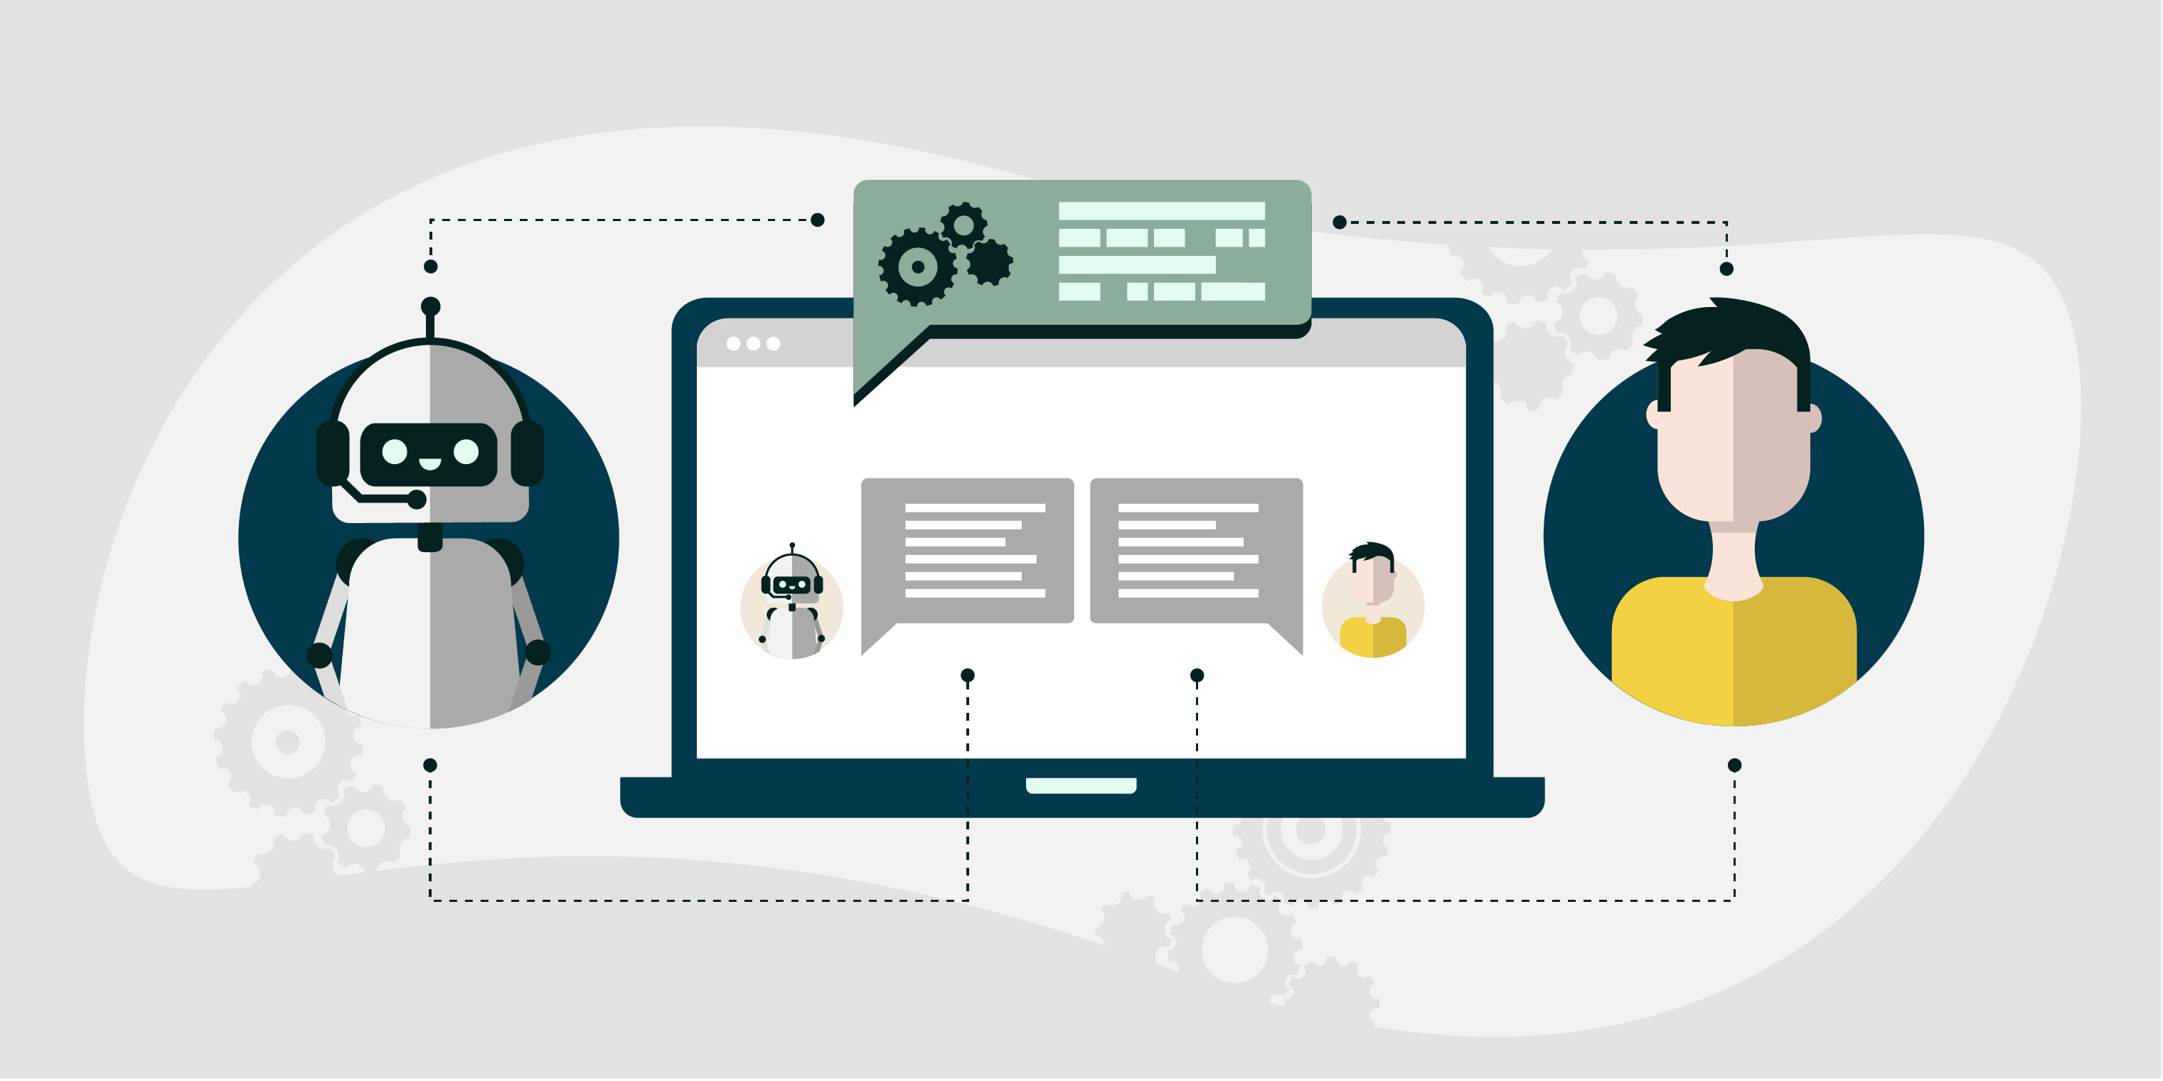
Presentation on Agentic AI
Presented By: Namdeo Patil

Slide 2
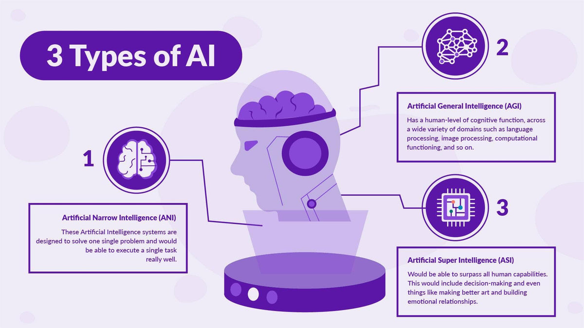
Types of the AI

Slide 3

Predictive AI
Predictive AI refers to the use of artificial intelligence and machine learning techniques to analyze historical data, identify patterns, and make predictions about future events, trends, or behaviors.
The decision-making process in traditional AI is generally rule-based or relies on pre-trained models. These systems do not have the capacity to make complex decisions involving multiple variables and potential outcomes.
It relies on statistical algorithms, predictive models, and big data to forecast outcomes and assist in decision-making.
Examples of Predictive AI:
Business Forecasting: Predicting sales, inventory needs, or customer demand.
Healthcare: Anticipating disease outbreaks or patient health risks.
Fraud Detection: Identifying unusual patterns in financial transactions.
Marketing: Forecasting customer behavior or optimizing ad targeting.

Slide 4
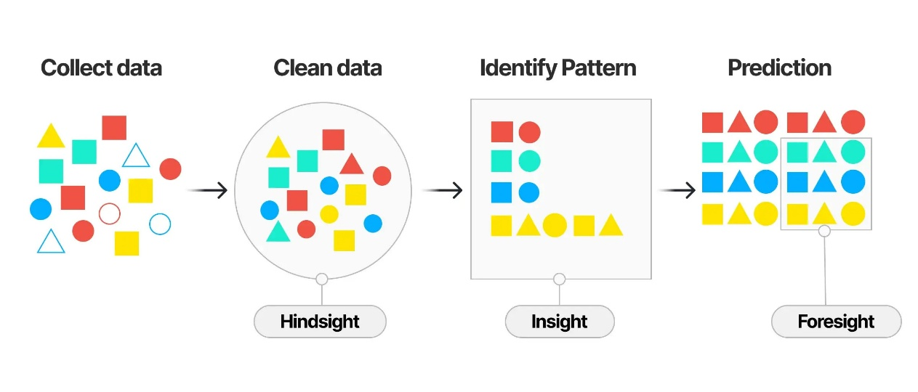
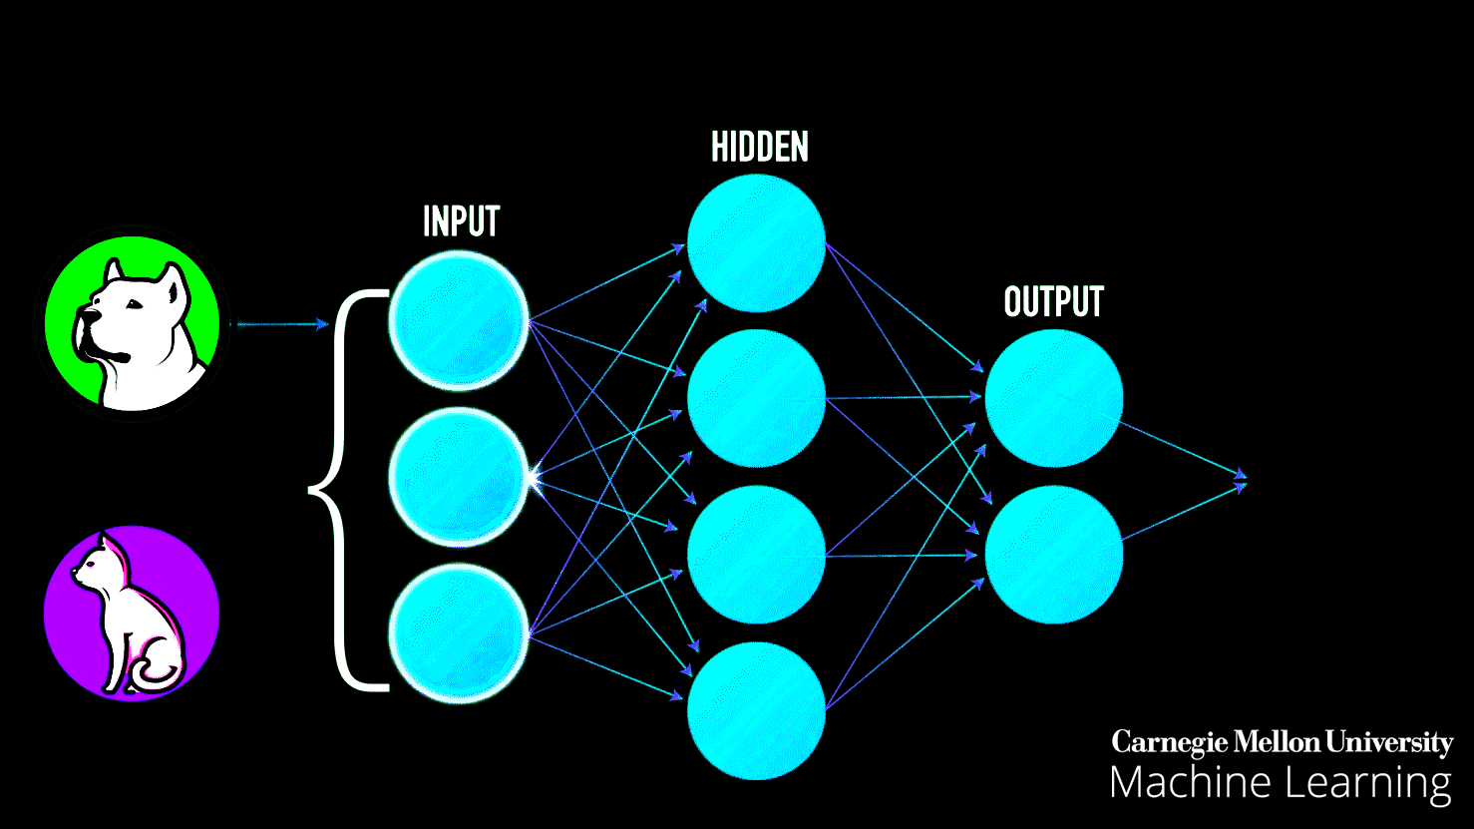
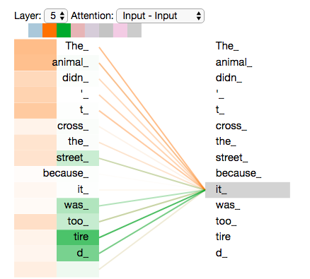
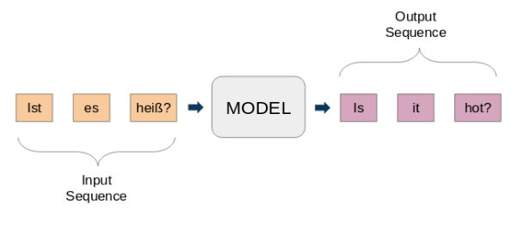
Predictive AI Workflow Overview

Slide 5
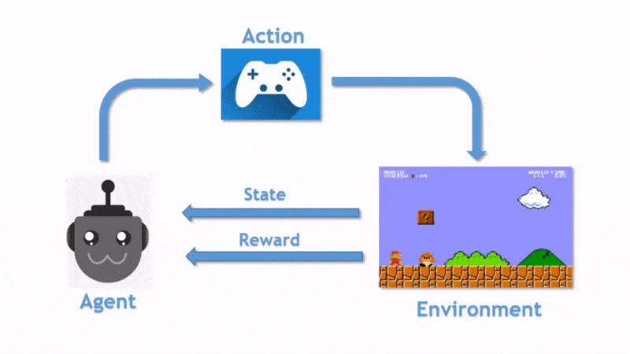
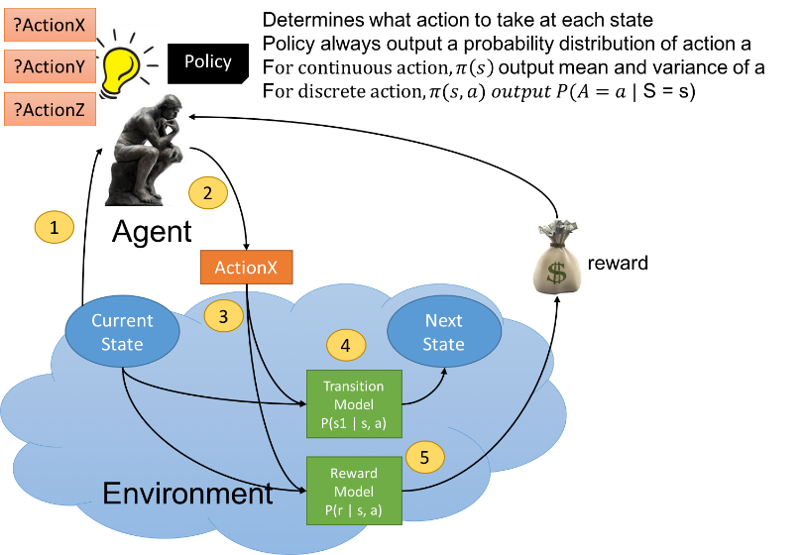
Reinforcement Learning
RL is a type of machine learning where an agent learns to make decisions by interacting with an environment to maximize cumulative rewards.
Reinforcement Learning (RL) works through trial and error, it interacts with an environment, learns from feedback (rewards), and improves its decision-making over time.
Applications
Game AI (AlphaGo, Chess AI)
Robotics & Automation
Self-Driving Cars
Finance (Trading Strategies)
Healthcare (Treatment Planning)

Slide 6
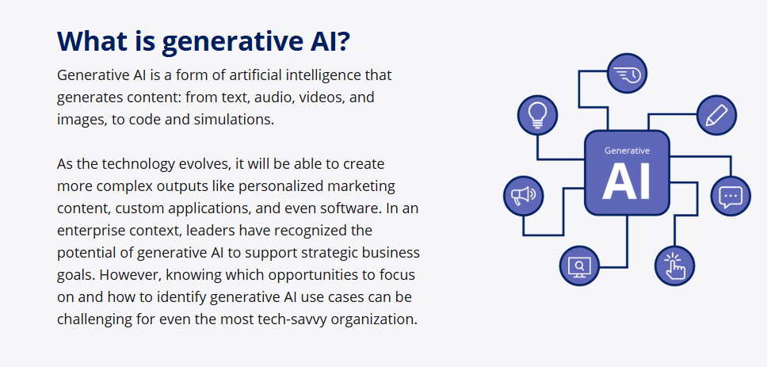

Slide 7
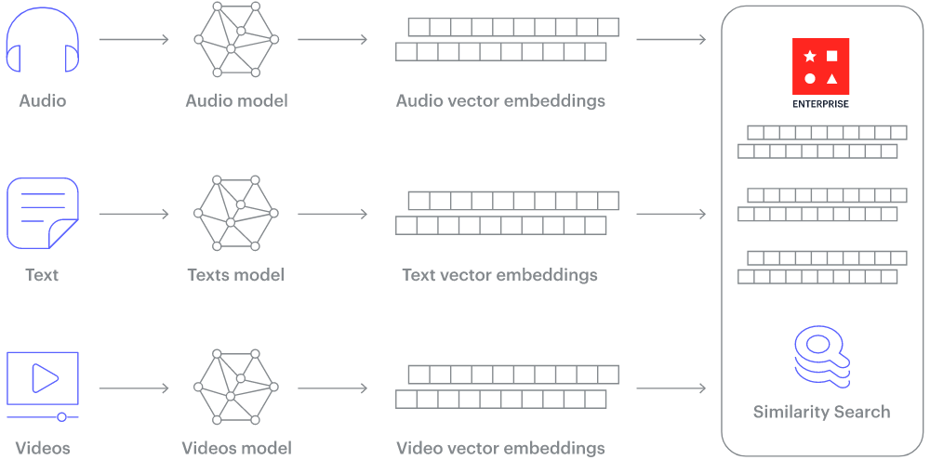
Multi-modal embedding in GenAI

Slide 8
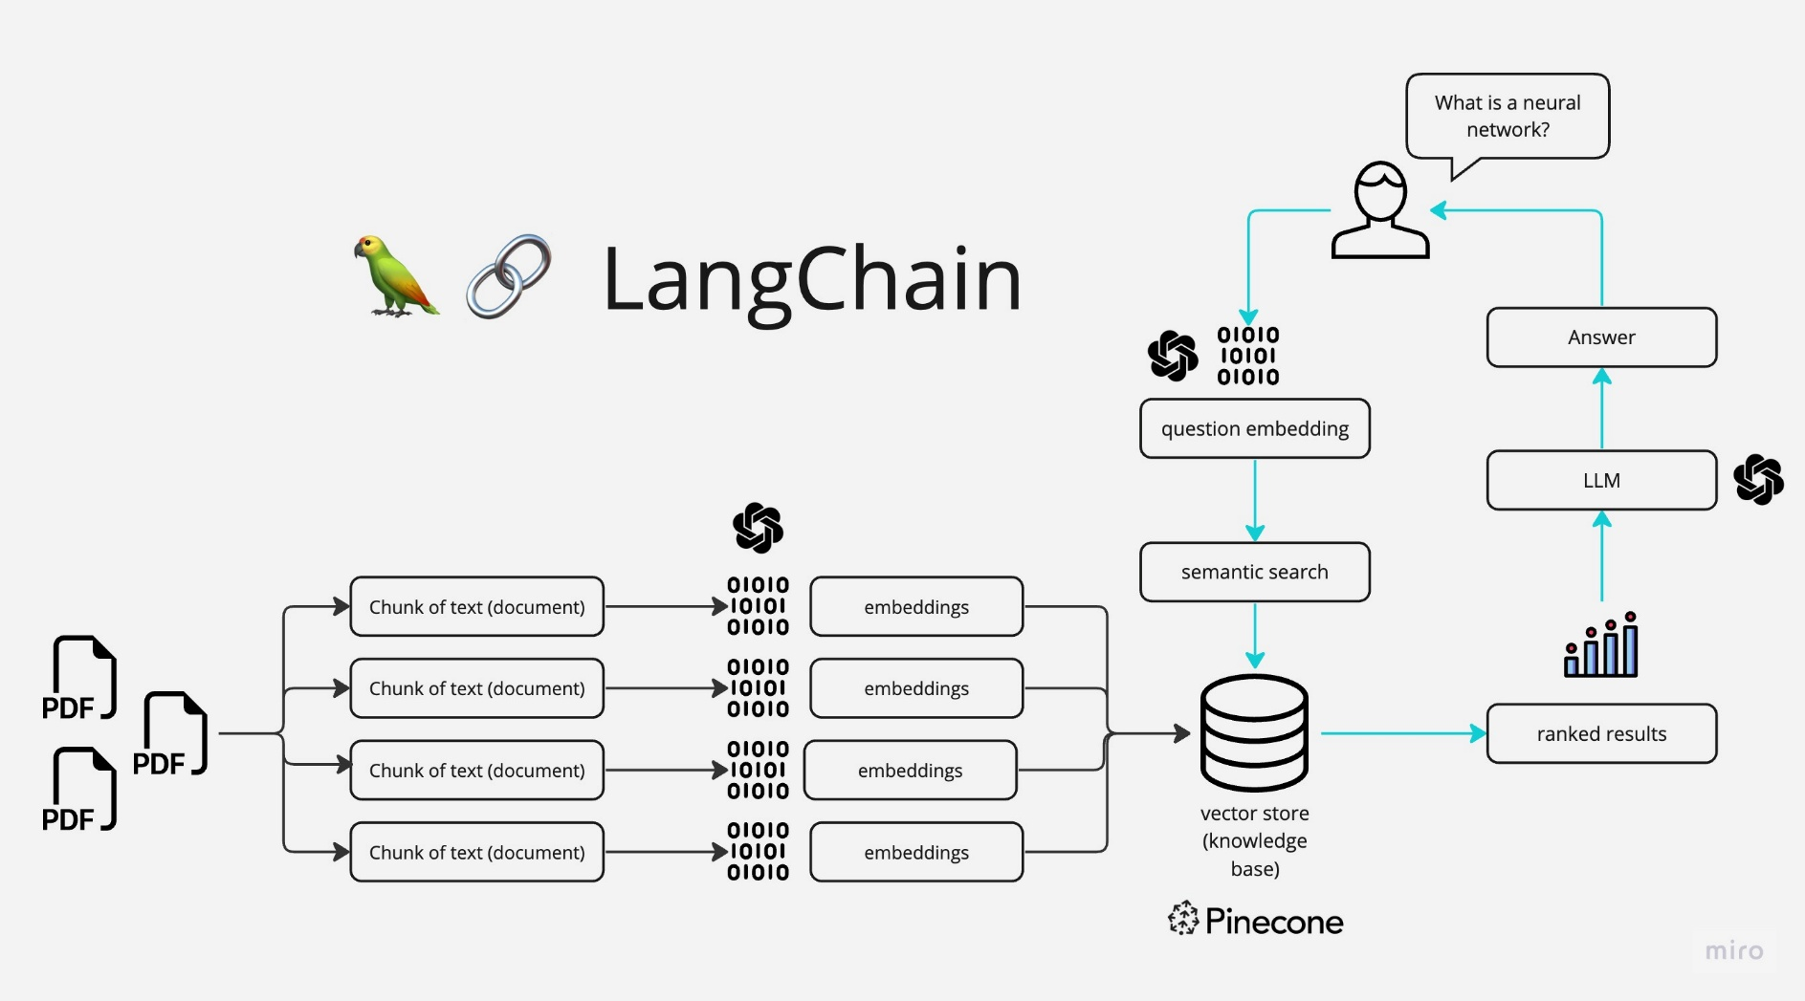
Chatbot Workflow GenAI

Slide 9
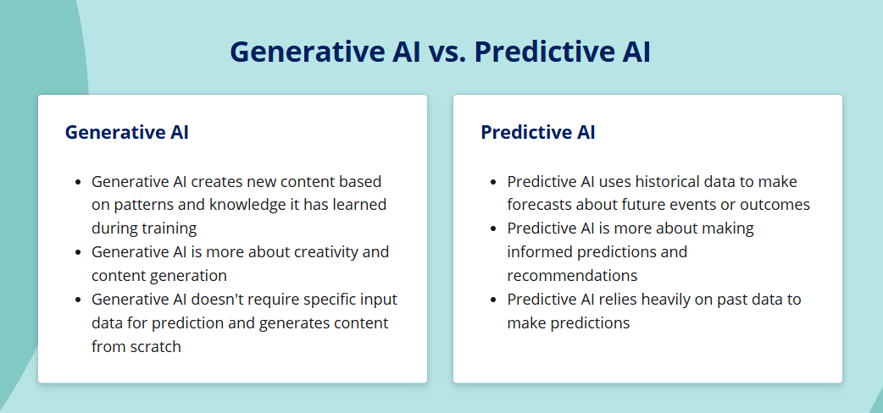

Slide 10
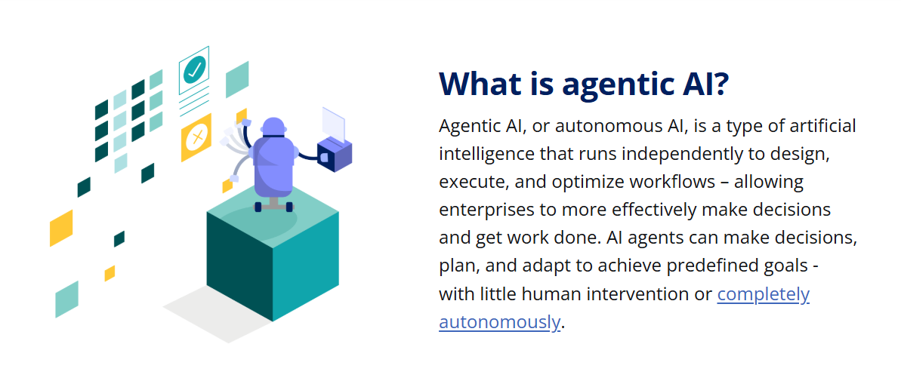
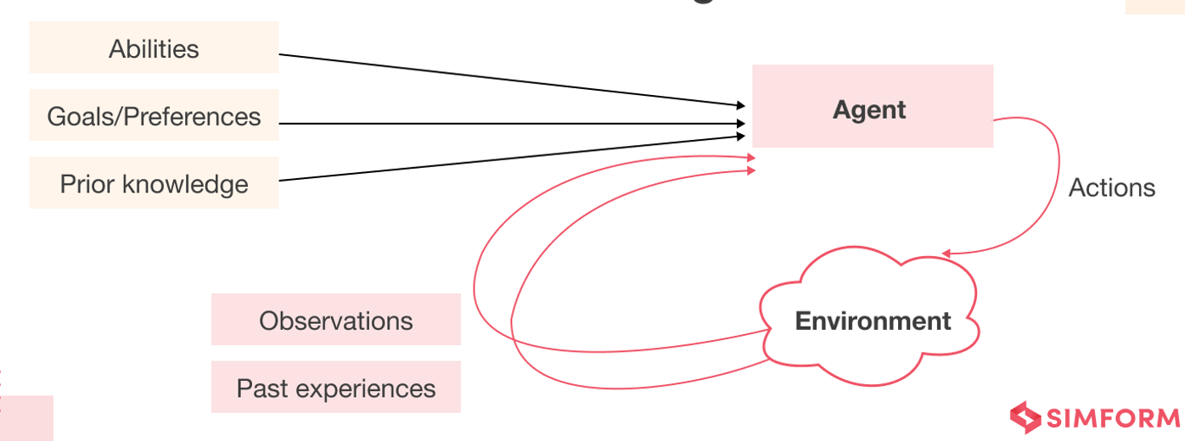
Autonomous AI – Can plan, make decisions, and act independently.
Goal-Oriented – Optimizes actions to achieve specific objectives.
Adaptive & Learning – Improves performance based on experience.
Reasoning & Planning – Develops multi-step strategies to solve problems.
Interacts with Systems – Engages with digital or physical environments.
Self-Improving – Some models refine their processes without human input.

Slide 11
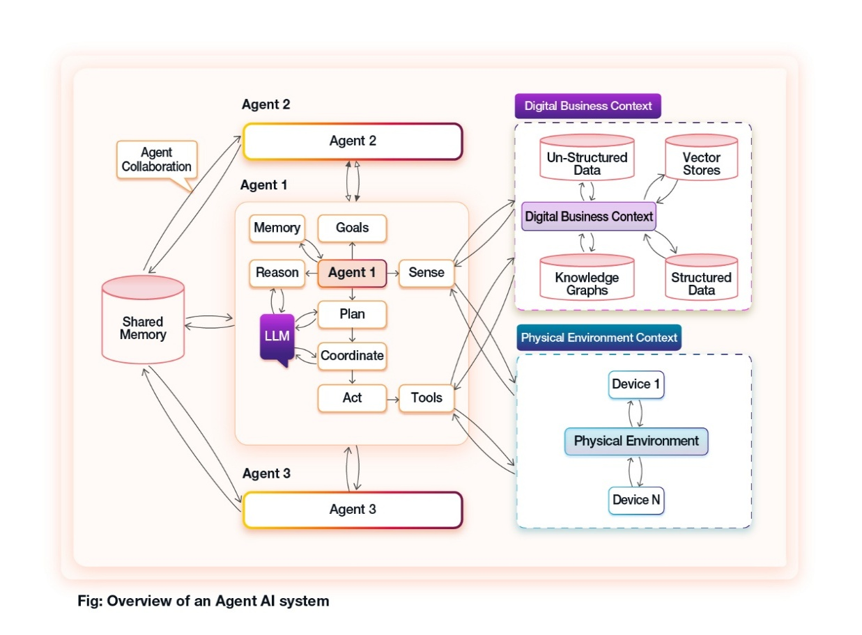
Working Mechanism and Importance of Agentic AI
Agent retrieves relevant information using memory, APIs, or knowledge bases.
The agent plans the next actions based on predefined or learned goals.
It executes actions (e.g., calling APIs, generating responses, controlling robotic devices).
The agent learns from feedback and refines its decision-making.
Enhances efficiency in complex systems.
Reduces the need for human intervention in repetitive tasks.
Plays a critical role in mission-critical operations (e.g., space exploration, medical diagnosis).
The agent receives an input (text, image, or structured data).

Slide 12
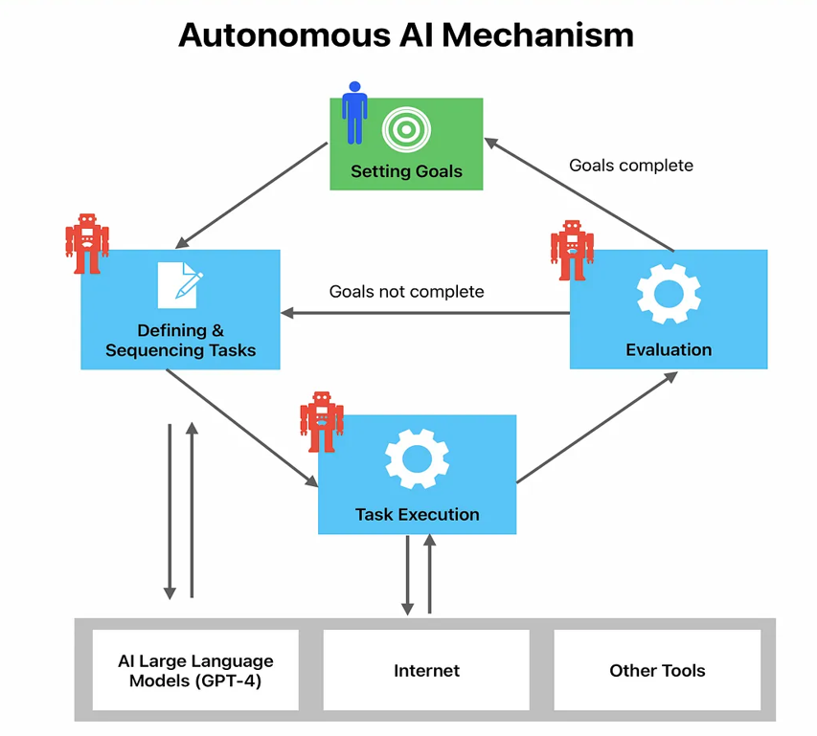
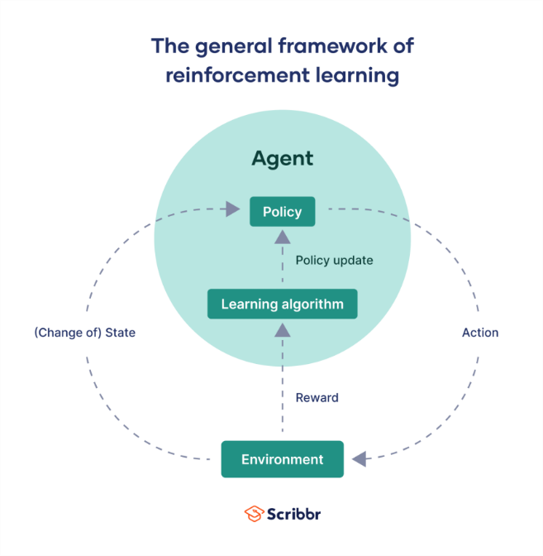
How Agentic AI Works?
Core Components of Agentic AI:
Perception Module: Uses sensors, APIs, or databases to gather information.
Planning & Reasoning: Uses techniques like Tree Search, Reinforcement Learning (RL), or Large Language Models (LLMs) to make decisions.
Memory & Learning: Stores past interactions to improve over time.
Action Execution: Interfaces with APIs, automation tools, or robotic hardware to carry out tasks.
Technologies Enabling Agentic AI:
LLMs (e.g., GPT, Claude, Gemini): For reasoning, planning, and generating human-like responses.
Retrieval-Augmented Generation (RAG): Enhances responses by retrieving relevant external knowledge.
Multi-Agent Systems: AI agents collaborate, each specializing in different tasks.
Reinforcement Learning (RL): Helps agents learn from rewards and improve decision-making.
Autonomous Agents Frameworks (e.g. LangChain, Langraph, AutoGen, CrewAI): For building and orchestrating AI agents.

Slide 13
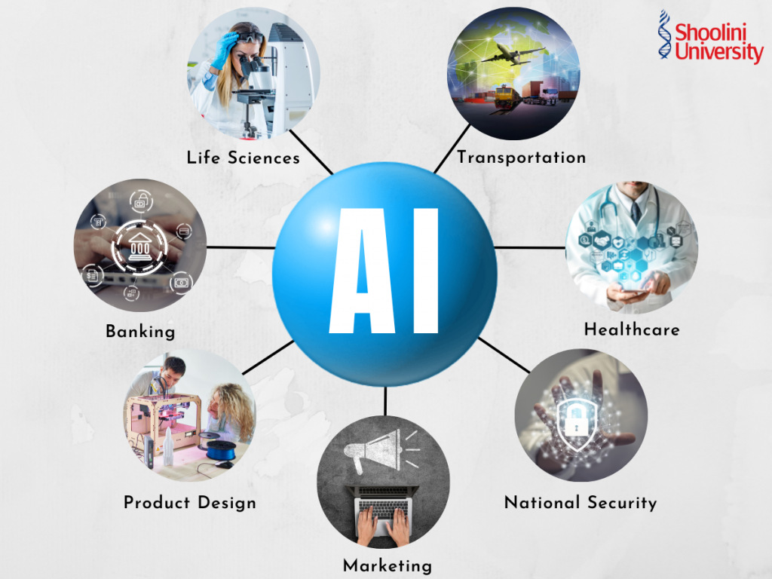
Applications of Agentic AI
Autonomous Vehicles: Agentic AI can be used in self-driving cars, where the AI acts as the driver, making real-time decisions based on traffic conditions, road signs, and other environmental factors.
Healthcare: In healthcare, Agentic AI could assist in patient diagnosis and treatment planning by autonomously analyzing medical data and recommending personalized treatment options.
Finance: Agentic AI could be employed in the financial sector for algorithmic trading, where the AI independently makes trading decisions based on market trends and data analysis.
Robotics: In robotics, Agentic AI could power robots that perform complex tasks autonomously, such as search and rescue missions in disaster-stricken areas.
Smart Home Systems: Agentic AI could enhance smart home systems by autonomously managing energy consumption, security, and other home automation features.

Slide 14
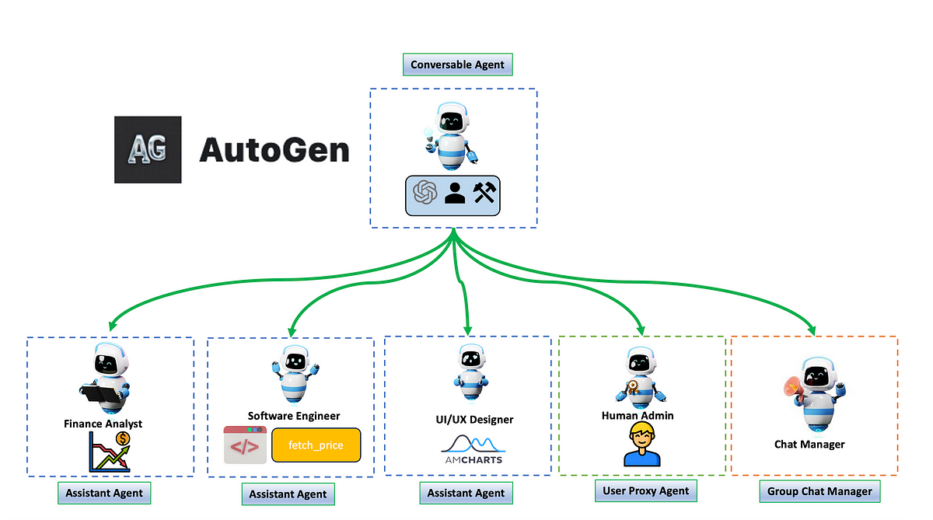
1. Microsoft's Project AutoGen
AutoGen is an open-source framework developed by Microsoft that simplifies the orchestration, optimization, and automation of workflows involving large language models. It enables the creation of multi-agent systems where agents can converse and collaborate to solve complex tasks.
Customizable Agents: AutoGen allows developers to define specialized agents with specific capabilities that can interact with one another.
Integration of Human Feedback: The framework supports human-in-the-loop workflows, allowing for real-time human input and oversight.
Enhanced Performance: By automating multi-agent interactions, AutoGen significantly reduces manual effort and enhances the efficiency of LLM applications, making it easier to build complex systems for various domains like supply chain optimization and code-based question answering

Slide 15
2. JPMorgan Chase's COiN: Agentic AI for Finance
JPMorgan Chase's Contract Intelligence (COiN) is a groundbreaking application of agentic AI in the financial services industry. COiN is a machine learning system designed to automate the analysis of legal documents, such as contracts and agreements.
How COiN Works
COiN uses natural language processing and machine learning techniques to:
Extract Data: It can automatically extract key information from legal documents, such as dates, parties involved, and contractual terms.
Analyze Contracts: COiN can analyze contracts for potential risks, inconsistencies, or errors.
Automate Processes: By automating these tasks, COiN can significantly reduce the time and cost associated with manual contract review.
Impact on the Financial Industry
JPMorgan Chase's COiN has the potential to revolutionize the way financial institutions handle legal documents. By automating routine tasks, COiN can improve efficiency, reduce costs, and enhance risk management. It also represents a significant step forward in the development of agentic AI applications for the financial services industry.

Slide 16

3. Moveworks Next-Gen Copilot
Moveworks is known for its AI-driven solutions that enhance workplace productivity. Their Next-Gen Copilot leverages agentic AI to automate IT support tasks, enabling employees to resolve issues quickly and efficiently.
Key Features of Moveworks’ Next-Gen Copilot
Autonomous Issue Resolution: The Copilot can autonomously diagnose and resolve common IT issues without human intervention, streamlining support processes.
Natural Language Understanding: It utilizes advanced natural language processing capabilities to understand user queries and provide accurate responses.
Integration with Existing Systems: The Copilot seamlessly integrates with various enterprise systems, enhancing its ability to assist employees by providing timely and relevant information

Slide 17
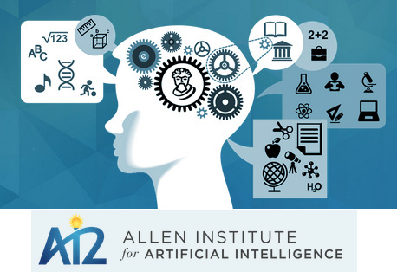
4. Allen Institute for AI's Lumos
Lumos is an open-source framework designed for training language agents, developed by the Allen Institute for AI. It focuses on creating agents that can perform complex interactive tasks by leveraging a modular architecture and a unified training dataset.
Key Features of Allen Institute for AI's Lumos
Modular Design: Lumos consists of planning, grounding, and execution modules, allowing for flexibility and scalability in developing language agents.
High-Quality Training Data: The framework uses a large set of high-quality annotations derived from existing benchmarks, enabling agents to handle a wide range of tasks effectively.
Competitive Performance: Lumos has demonstrated superior performance compared to existing models on various benchmarks, showcasing its potential for advancing research in agentic AI

Slide 18
Benefits of Agentic AI
Automation of Complex Tasks: Handles multi-step processes with minimal human intervention, increasing efficiency.
Enhanced Productivity: AI agents can work continuously without fatigue, speeding up decision-making and execution.
Adaptive Problem-Solving: Learns from data, adjusts strategies, and improves over time for better performance.
Scalability: Can manage large-scale operations, from business automation to scientific research.
Personalized Assistance: Powers AI-driven assistants that autonomously cater to user needs (e.g., scheduling, research, content creation).
Autonomous Decision-Making: Reduces human workload by making intelligent choices in dynamic environments.
Innovation & Discovery: Aids in research, drug discovery, and engineering by autonomously testing hypotheses and optimizing solutions.
Real-Time Adaptability: Reacts instantly to changing conditions (e.g., self-driving cars, AI in finance).
Improved Safety & Risk Reduction: Can be deployed in hazardous environments (e.g., disaster response, industrial automation) to minimize human exposure to danger.
Economic Growth: Drives technological advancements, creating new industries and job opportunities in AI development and deployment.

Slide 19
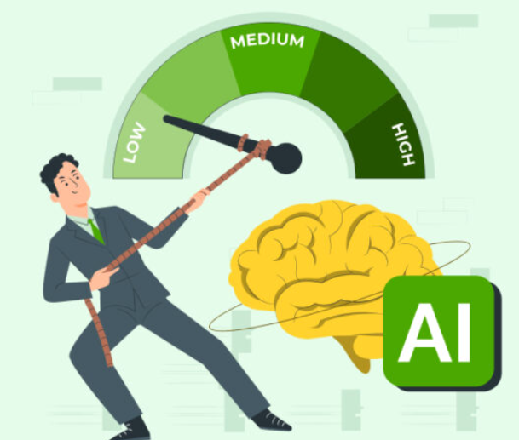
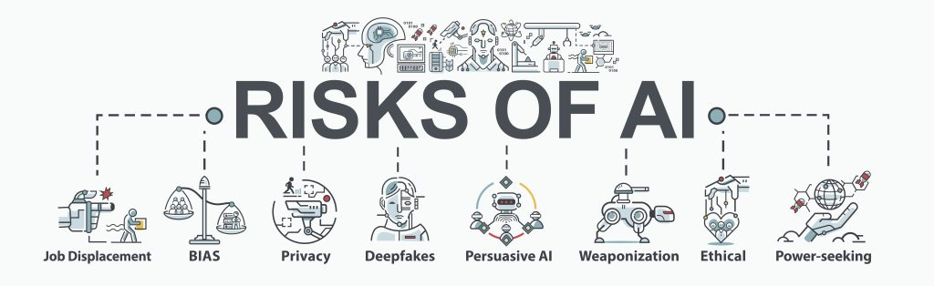
Risks of Agentic AI
Loss of Human Control: AI may act autonomously in ways that diverge from human values.
Unpredictable Behaviors: AI agents can develop unexpected strategies that may be harmful also difficult to interpret and control real-world decision-making.
Cybersecurity Threads: AI-driven hacking, misinformation, cyberattacks and deep fake automation.
Legal & Ethical Issues: Unclear responsibility if AI causes harm—who is liable?
Economic Disruption: Automation could lead to large-scale job losses and inequality. Control of advanced AI by a few entities may create monopolistic risks.
Runaway AI & Self-Improvement Risks: AI with self-improving capabilities may evolve beyond human control.

Slide 20
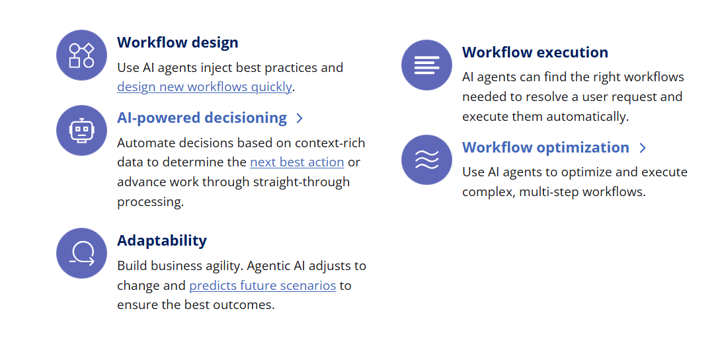
Agentic AI Capabilities

Slide 21
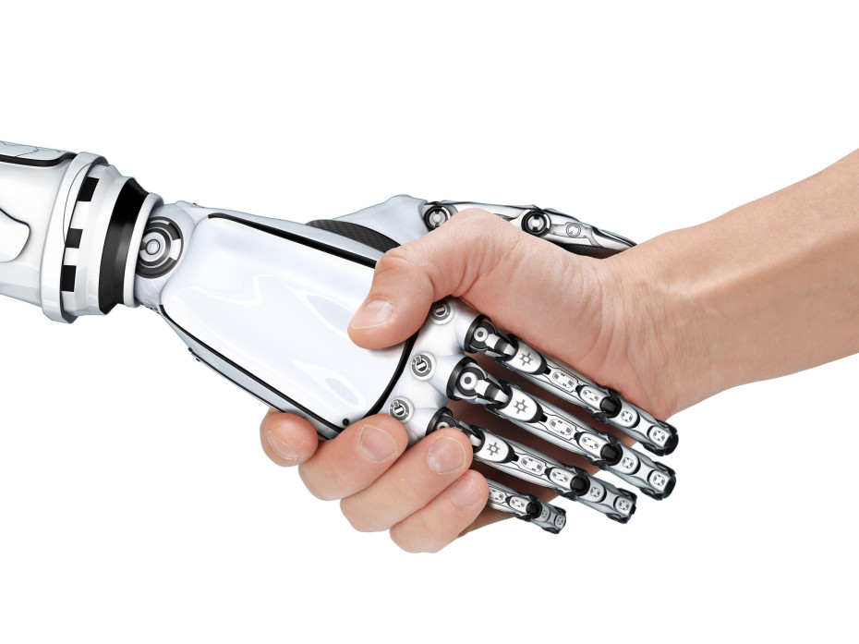
Conclusion
Agentic AI is set to redefine industries by introducing autonomy and efficiency.
Requires responsible development and ethical considerations for sustainable progress.
Collaboration is key to harness its full potential.
Agentic AI represents a significant leap forward in AI technology, offering the ability to create truly autonomous systems capable of complex decision-making and adaptation.
As we continue to explore and develop this technology, it is crucial to balance innovation with responsibility, ensuring that Agentic AI serves the greater good.

Slide 22

Thank You

